Slide 1
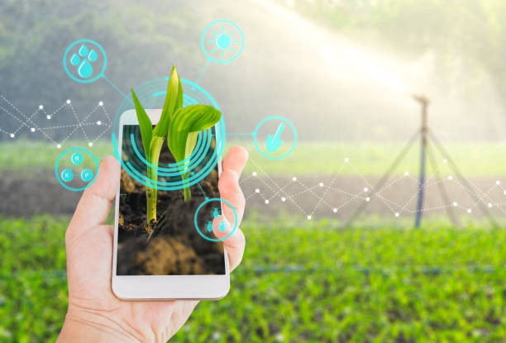
NAME:T.AKANKSHA COLLEGE:CHAITANYA BHARATHI INSTITUTE OF TECHNOLOGY YEAR:3rd BRANCH:ELECTRONICS AND COMMUNICATION(ECE)

Slide 2
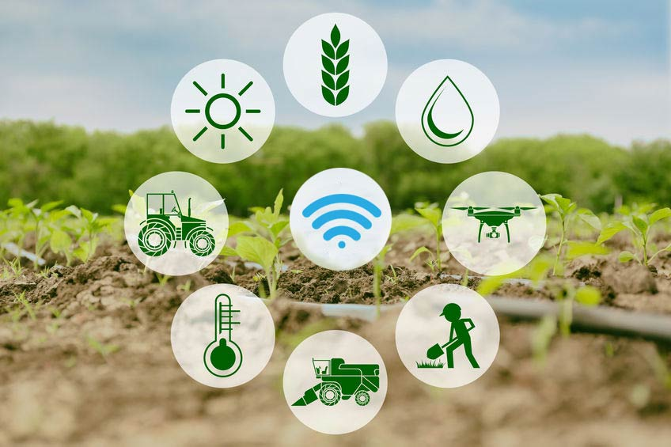
SMART AGRICULTURE SYSTEM BASED ON IOT

Slide 3
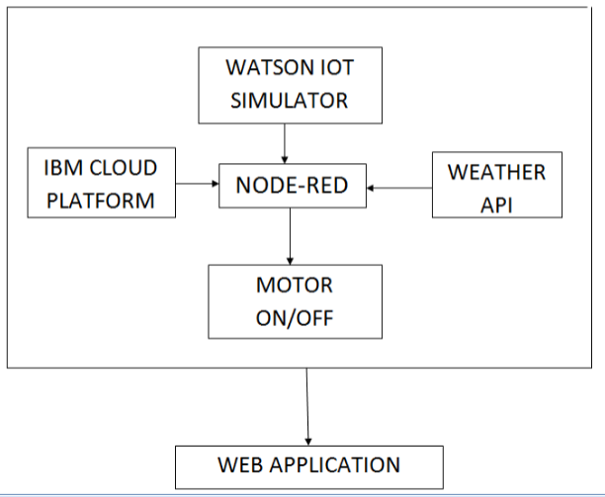
BLOCK DIAGRAM

Slide 4
FUTURE SCOPE
By maintaining various sensors information on cloud, user can access or control over his farm activities.
Extensible feature of sensors we can add as per crop specific need.
We can add motion sensors for monitoring behavior of animals.

Slide 5

CONCLUSION

